Slide 1
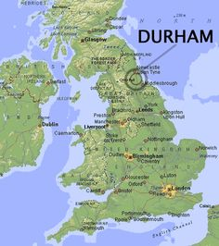
Thirty* graphical tips Stata users should know, revisited
* or so
Nicholas J. Cox
Department of Geography

Slide 2
thirtysomething
I gave a talk at the 2010 London meeting presenting thirty graphical tips.
The display materials remain accessible on Stata's website.
However, they are a series of .smcl and .gph files and awkward to view.
Here are some of those tips, and many new ones.
You or your team might consider them when designing and coding graphics.
The talk mixes examples from official and community-contributed commands and details both large and small.
The theme of thirty matches this 30th London meeting, and to a good enough approximation my 33 years as a Stata user.

Slide 3
Ground rules
Examples won’t include full Stata code.
Code to be posted online will be fully reproducible.
I use Stata 18 with various other commands installed, as will be explicit.
If you are using an earlier version of Stata, watch out for scheme stcolor. You will need to use a different scheme.
SJ means Stata Journal.
SSC means Statistical Software Components archive.

Slide 4

We have not looked at our results until we have displayed them effectively.
John Wilder Tukey. 1977. Exploratory Data Analysis. Reading, MA: Addison-Wesley, p.56.
1915–2000

Slide 5
Small stuff
The devil is often in the details…

Slide 6
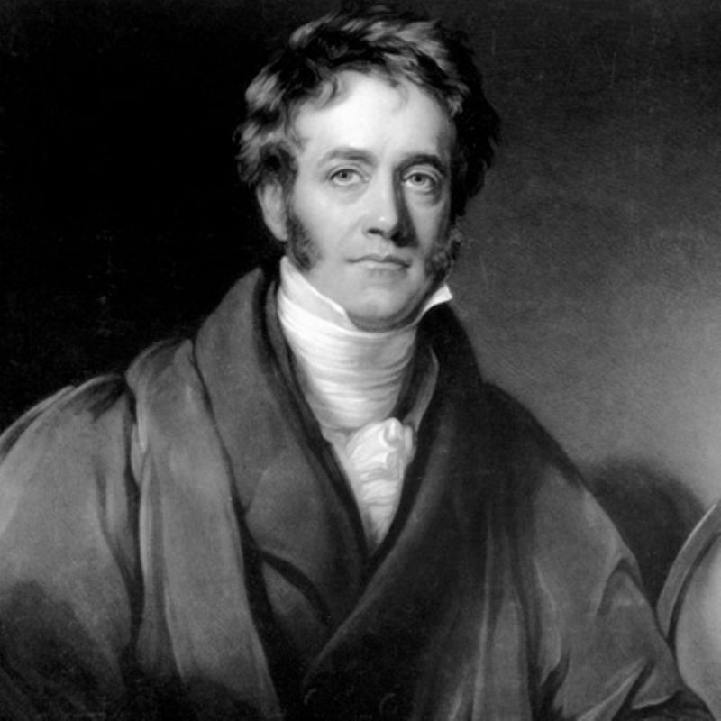
Scatter plots
The scatter plot is the workhorse of statistical graphics.
John M. Chambers. 1977. Computational Methods for Data Analysis. New York: John Wiley, p.221.
Its invention is attributed to
Sir John Herschel (1792—1871).

Slide 7
Use open markers
To me open or hollow circles Oh or oh are the most suitable default marker symbols, as they tolerate overlap well and are easier on the eye.
Other open markers, such as squares, diamonds and triangles, often work well too.
Plus signs + combine well with open markers, even when values are almost or exactly identical.
Resist the puzzling fashion that every marker is a solid circle!

Slide 10
Use marker labels as markers
You can use marker labels as markers with
mlabel(varname) mlabpos(0)
where variable varname can usefully contain (say) single characters, such as a-z or 0-9, or two- or three-letter abbreviations (TLAs).
See SJ 5: 604–606 (2005).
Compare using marker labels and markers together.

Slide 13
Go grey
Grey is good for markers and lines in a backdrop: more examples later.
You can usually publish graphs with grey when a journal won't support full colour.
Ordered sequences are clear when classifying data points. Use both mfcolor() and mlcolor(). Darker outline colours enhance visibility.
See SJ 5: 604―606 (2005).

Slide 15
Labels without ticks can make sense
Labels without ticks are good for
times placed at interval midpoints
category names on one axis of a twoway graph.
See SJ 7: 590―592 (2007)
and more generally on ticks SJ 19: 741―747 (2019).

Slide 18
Use ticks or pipes in marginal rug plots
Precisely which values occur in the data?
levelsof can yield a list.
Kernel density estimates can be easier to interpret with a sight of distinct data values.
Rugs go back at least to
David Brunt. 1917. The Combination of Observations. London: Cambridge University Press.
Can you give an earlier example?

Slide 20
Use nice labels for logarithmic scales
With logarithmic scales, multiples of 1, 3, 10 or 1, 2, 5, 10 look good as labels.
log base 10 of 3 is 0.477.
log base 10 of 2 is 0.301; of 5 is 0.699.
See niceloglabels and SJ 18: 262–286 (2018).

Slide 22
Consider other nonlinear scales
Although Stata privileges only linear and logarithmic scales, any nonlinear scale may be helpful for graphs (square root, reciprocal, logit, etc.) so long as you can do the calculations and fix the axis labels.
See SJ 8: 142–145 (2008) and SJ 22: 975–995 (2022), especially the mylabels command.
This example uses a logit scale for illiteracy. Illiteracy has bounds 0 and 100% and something like a downward S-curve over time is often seen. Logit scale stretches the tails relative to the middle.

Slide 24
Omit needless axis titles
Standard examples of needless titles are Time or Date or Year.
Who needs such titles, really?
Your teachers (should have) told you to explain each axis, showing definitions and units of measurement. They were right, except that sometimes a rule may be broken without damage.

Slide 26
Lose the legend! Kill the key!
Legends are at best necessary evils: they oblige mental back and forth between legend items and data display and they can take up much valuable real estate.
Obnoxious examples are common with multiple time series, especially if a graph is tangled spaghetti.
Better solutions may be direct labelling in the data region; axis labels; or panel subtitles.
You may need a reshaped data layout. See e.g. SJ 20: 1016–1027 (2020)
Matching text and lines or markers in colour is harder work, but usually worth the extra effort.

Slide 29
Horizontal is good
Most of us find it easier to read good-sized full horizontal text, not vertical or angled or over-reduced text or cryptic abbreviations.
The principle that graphics must be readable may need to override a convention that responses or outcomes go on the vertical axis.
Faced with a simple problem — not enough space for category labels with a bar or column chart — the simplest solution is to go horizontal.
Incidentally, when graphs have table flavour, consider whether the horizontal axis would be better at the top. See SJ 12: 549–561 (2012).

Slide 32
Use lpoly for scatter plot smoothing
Stata offers several methods that are possible scatter plot smoothers.
My affections have shifted over time but lpoly is my current favourite. It is highly flexible, fairly easy to explain, and associated with confidence interval machinery.
You may need to fight its defaults. See localp from SSC.
Still, it's a folk theorem that reasonable smoothers agree.
Generic advice: Always explain quite how and how much you smoothed.
If you don’t, some readers will be curious or even furious.

Slide 34
Convenient commands
Some personal favourites…

Slide 35
graph dot
graph dot is a greatly under-rated command. It encourages focus on comparison of values and use of nonlinear scales. It allows zeros to be omitted if they are irrelevant.
Many bar charts would work as well or better presented as dot charts.
The term Cleveland dot chart honours the advocacy of William S. Cleveland — e.g. American Statistician 38: 270–280 (1984) — but the idea can be found in George W. Snedecor’s text from 1937.
Detail: I have found that the default dotted line grid can degrade on porting to other software.
I recommend options such as linetype(line) lines(lw(vthin) lc(gs12))

Slide 37
stripplot for strip plots (and much more)
stripplot from SSC has morphed into (in effect) a superset of official command dotplot.
The focus is univariate distribution displays in which each data point is a separate marker.

Slide 39
Beyond box plots
Box plots are often poor choices. They may omit helpful detail or other pertinent summaries. They can be too easy to misinterpret, especially in the tails.
Tukey’s rule of plotting individually data points if they are more than 1.5 IQR from the nearer quartile has lost whatever good rationale it had.
One alternative is a quantile-box plot that combines a quantile plot and a box plot. The term and the idea come from Emanuel Parzen (1929–2016).
One design makes literal the simple point that one half of the data points belong inside the box, and so the other half belong outside the box.
Detail: Box plots under different names have a long history, including notably their use by geographers from 1933 on and going back at least as far as A.L. Bowley’s recommendation circa 1897 to use various quantiles in distribution display.
See (again) stripplot from SSC.

Slide 42
I suggest that these displays are easier to think about than the puzzlingly fashionable superimposition of jittered dots on box plots.
See also qbplot from SSC for a pedagogic or propaganda version.

Slide 43
As Nero Wolfe said in a different context
Tradition should be respected but not sanctified.
Rex Stout. 1975. A Family Affair. New York: Viking Press. Ch.3
Often, the less there is to justify a traditional custom, the harder it is to get rid of it.
Mark Twain. 1876. The Adventures of Tom Sawyer. Hartford, CT: American Publishing Company. Ch.5.

Slide 44
qplot (and qqplotg) for quantile plots
The main idea of quantile plots is just to plot ordered values against a version of cumulative probability. Using plotting positions such as (rank − 1/2) / sample size allows easy transformations. Normal quantile plots are just the most familiar examples for many people.
qplot and qqplotg from the Stata Journal are in effect supersets of official commands quantile and qqplot.
See
SJ 24(3): in press (2024)
SJ 7: 275–279 (2007)
SJ 5: 442–460 (2005)

Slide 46
fabplot for front-and-back plots
Front-and-back plots (my name, but not my idea) display each subset in turn in front with the other subsets as backdrop. The idea combines superimposed and juxtaposed plotting, with (sometimes) the benefits of both styles.
See SJ 21: 539–554 (2021)
SJ 19: 989–1008 (2019)
SJ 10: 670–681 (2010)
SJ 9: 499–503 (2009).
Some people struggle with multiple markers or line patterns or colours and a legend for each item. That battle is often lost before it starts.
The example with 20 countries as panels is suggested to be of a size where different colours, marker symbols or line patterns would not work well. Any of those would require a legend, which itself would take up space.

Slide 48
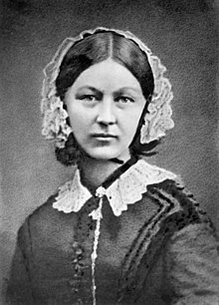
Florence Nightingale’s data on deaths in Crimean War
Florence Nightingale (1820–1910) had a strongly statistical approach to medical and other questions among other outstanding contributions.
She reported on deaths of British soldiers in the Crimean War, recording numbers due to zymotic disease (loosely, infections), wounds and injuries, and all other causes.
Her circular graph is much repeated and lauded. How does a front-and-back compare?

Slide 49
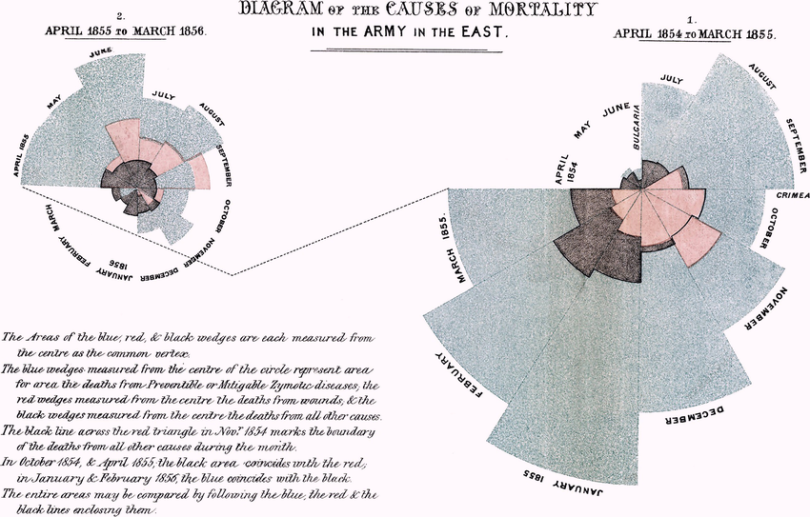

Slide 51
tabplot for multiway bar charts
Stacked or divided bars are easy to understand in principle, but often not so effective in practice.
Pulling the bars apart in a table-like display lets zeros and small amounts or counts be visible as such and allows annotation, thus hybridizing graph and table ideas.
See SJ 16: 491–510 (2016) and later Software Updates.
Usually a legend can be omitted, as the axis labels explain categories or variables.
The earliest example I know comes from Charles Booth’s team studying labour and life in London in 1889.

Slide 53
designplot for summaries by categorical predictors
designplot is a rewriting and generalization of official command grmeanby.
Its forte is showing results at two or more levels of aggregation or amalgamation. It is thus available to explore and explain amalgamation paradoxes such as Simpson’s (Yule’s, Pearson’s).
See SJ 14: 975–990 (2014) and updates.

Slide 55
cycleplot for cycle plots
Data mixing longer term and shorter term variations in time are often helpfully shuffled to group Januarys or Mondays or whatever. That cuts down on truthful but unhelpful roller-coaster displays.
The idea was pushed vigorously and successfully by Bell Labs statisticians from the late 1970s on but can also be found in much older literature.
The example shows first a conventional line plot (month within year) and then a cycle plot (year within month).

Slide 58
Stata strategy
Four simple points follow…

Slide 59
Stata technique: four simple tips quickly
When a command gets complicated, copy it to the Do-file Editor, space it out, and revise it as the equivalent of a do-file.
Use name() to keep graphs within a session.
Use graph save or save() to keep graphs beyond a session. .png can work well (and is required for Statalist).
The Graph Editor is especially useful for polishing graphs for presentation or publication.

Slide 60
Broader themes
Always think about the big picture too…

Slide 61
Choose colours carefully
Too many colours can confuse, not clarify.
Red and blue and orange and blue are good contrasting pairs.
Never use red and green together (colour blindness!)
Rainbows are beautiful, but they belong in the sky.
Soften large patches of colour.
Black may seem boring but is a standard with good reason.

Slide 62
Transparency helps readability
Reducing and clarifying overlap on scatter plots with many data points is perhaps the most obvious application of transparency.
Showing probability densities as areas is another good example. The interpretation of area as representing probability ties in with any virtue it has psychologically.
Showing convex hulls is another. On a scatter plot a convex hull is the smallest convex polygon including a (sub)set of points. Here include implies that data points are either vertices (corners) or inside the polygon.
See this Statalist thread if interested in convex hulls.

Slide 64
Show differences
All graphical purposes need or imply comparisons. Comparisons often require focus on differences between values – possibly on a transformed scale.
If your interest is in differences, why not calculate and plot them directly?
Examples include
residual plots
plots of differences versus means
plots of differences between corresponding quantiles.
The example following shows weight changes of anorexic girls under different treatments.
See SJ 9: 621–639 (2009) and SJ 24(4): in press (2024).

Slide 67
Sorting helps
The order in which data arrive may be arbitrary or uninformative.
Alphabetical or identifier order may be a particularly dopey default for graphics.
Sort instead on amount or count, latest value, or anything closer to the problem.
Among other methods, consider the myaxis command from SJ 21: 818–837 (2021).
In the original paper for the following example, both Welsh county names and land uses were ordered alphabetically.
Howard Wainer has rightly mocked this practice as Alabama first!

Slide 69
Use small multiples
Small multiples (Edward R, Tufte’s term) use the same idea repeatedly over multiple groups or variables.
Scatter plot matrices through graph matrix are one example. Any graphical method that supports an over() or a by() option could be another.
As a last resort, use graph combine.
Before that, consider reshaping data to allow use of by() or over().

Slide 70
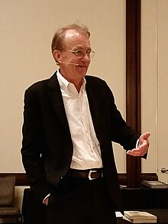
Show the data!
To improve learning from data, credibility, and integrity, show the data.
Edward R. Tufte. 2020. Seeing with Fresh Eyes: Meaning, Space, Data, Truth. Cheshire, CT: Graphics Press, p.101.

Slide 71
Graphs are for people
Why produce a graph?
explorations
indications
conclusions
Who is the graph for?
colleagues
clients
citizens
Graphics is – and yet is not – a spectator sport.
Given a novel or unfamiliar design, you need to play actively using data of interest to judge it fairly.
Does it convey what you already know, easily and effectively?
Does it tell you anything new and helpful?

Slide 72

The purpose of computing is insight, not pictures.
Lloyd Nicholas Trefethen. 2011.
Trefethen’s Index Cards: Forty years of notes about People, Words and Mathematics.
Singapore: World Scientific, p.330 [3 March 1997]

Slide 73
Resources
The Graphics manual [G], naturally.
Michael N. Mitchell. 2022. A Visual Guide to Stata Graphics. College Station, TX: Stata Press. Especially useful as a reverse reference on official commands. Find a graph you like; see which command produced it.
Stata Journal. The column Speaking Stata often discusses graphics. Many of the Tips in each issue are graphical.
The SSC archive also includes many user-written commands.

Slide 74

All such presentations are partial, if not prejudiced.
These were some of my tips for graphics. What are yours?
The next few slides gather together tips in summary form.
Some extras follow.

Slide 75
Reprise: small stuff
Use open markers
Use marker labels as markers
Go grey
Labels without ticks can make sense
Use ticks or pipes in marginal rug plots
Use nice labels for logarithmic scales
Consider other nonlinear scales
Omit needless axis titles
Lose the legend! Kill the key!
Horizontal is good
Use lpoly for scatter plot smoothing

Slide 76
Reprise: convenient commands
graph dot
stripplot
qplot
qqplotg
fabplot
tabplot
designplot
cycleplot

Slide 77
Reprise: Stata strategy
Do-file Editor
name()
graph save and save()
Graph Editor

Slide 78
Reprise: broader themes
Choose colours carefully
Transparency helps readability
Sorting can help
Show differences
Use small multiples
Show the data!
Graphs are for people

Slide 79
Quotations on normal quantile plots
Yudi Pawitan (2001, 92)
The normal QQ-plot is a useful exploratory tool even for nonnormal data. The plot shows skewness, heavy-tailed or short-tailed behaviour, digit preference, or outliers and other unusual values.
Ramanathan Gnanadesikan (1977, 168; 1997, 193)
Although a normal probability plot does not provide a single-statistic-based formal test, as a graphical tool it conveys a great deal more information about the configuration of the observations than any single summary statistic is likely to do.
Michael Hills (1974, 28)
It can be useful to plot an observed distribution against the standard Gaussian even though there is no question of it being Gaussian in shape. The motive is that it is easier to study a distribution by comparing it with a standard shape than just by looking at it.

Slide 80
Pawitan, Y. 2001.
In All Likelihood: Statistical Modelling and Inference Using Likelihood.
Oxford: Oxford University Press.
Gnanadesikan, R. 1977.
Methods for Statistical Data Analysis of Multivariate Observations.
New York: John Wiley. (second edition 1997)
Hills, M. 1974.
Statistics for Comparative Studies.
London: Chapman and Hall.

Slide 81
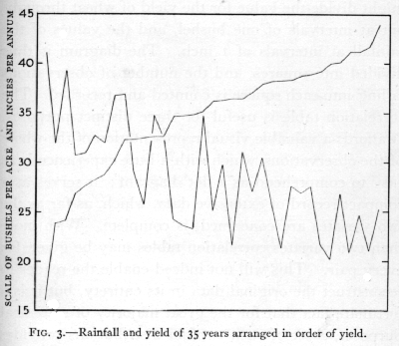
The preliminary examination of most data is facilitated by the use of diagrams. Diagrams prove nothing, but bring outstanding features readily to the eye; they are therefore no substitute for such critical tests as may be applied to the data, but are valuable in suggesting such tests, and in explaining the conclusions founded upon them.
Ronald Aylmer Fisher. 1925. Statistical Methods for Research Workers. Edinburgh: Oliver and Boyd, S.7. 1890–1962

Slide 82
This was a presentation at the Stata London meeting, 12 September 2024.

